Slide 1
AZURE PROJECT
NAME: SREELEKSHMI K V
MAIL ID:214416@ust-global.com

Slide 2
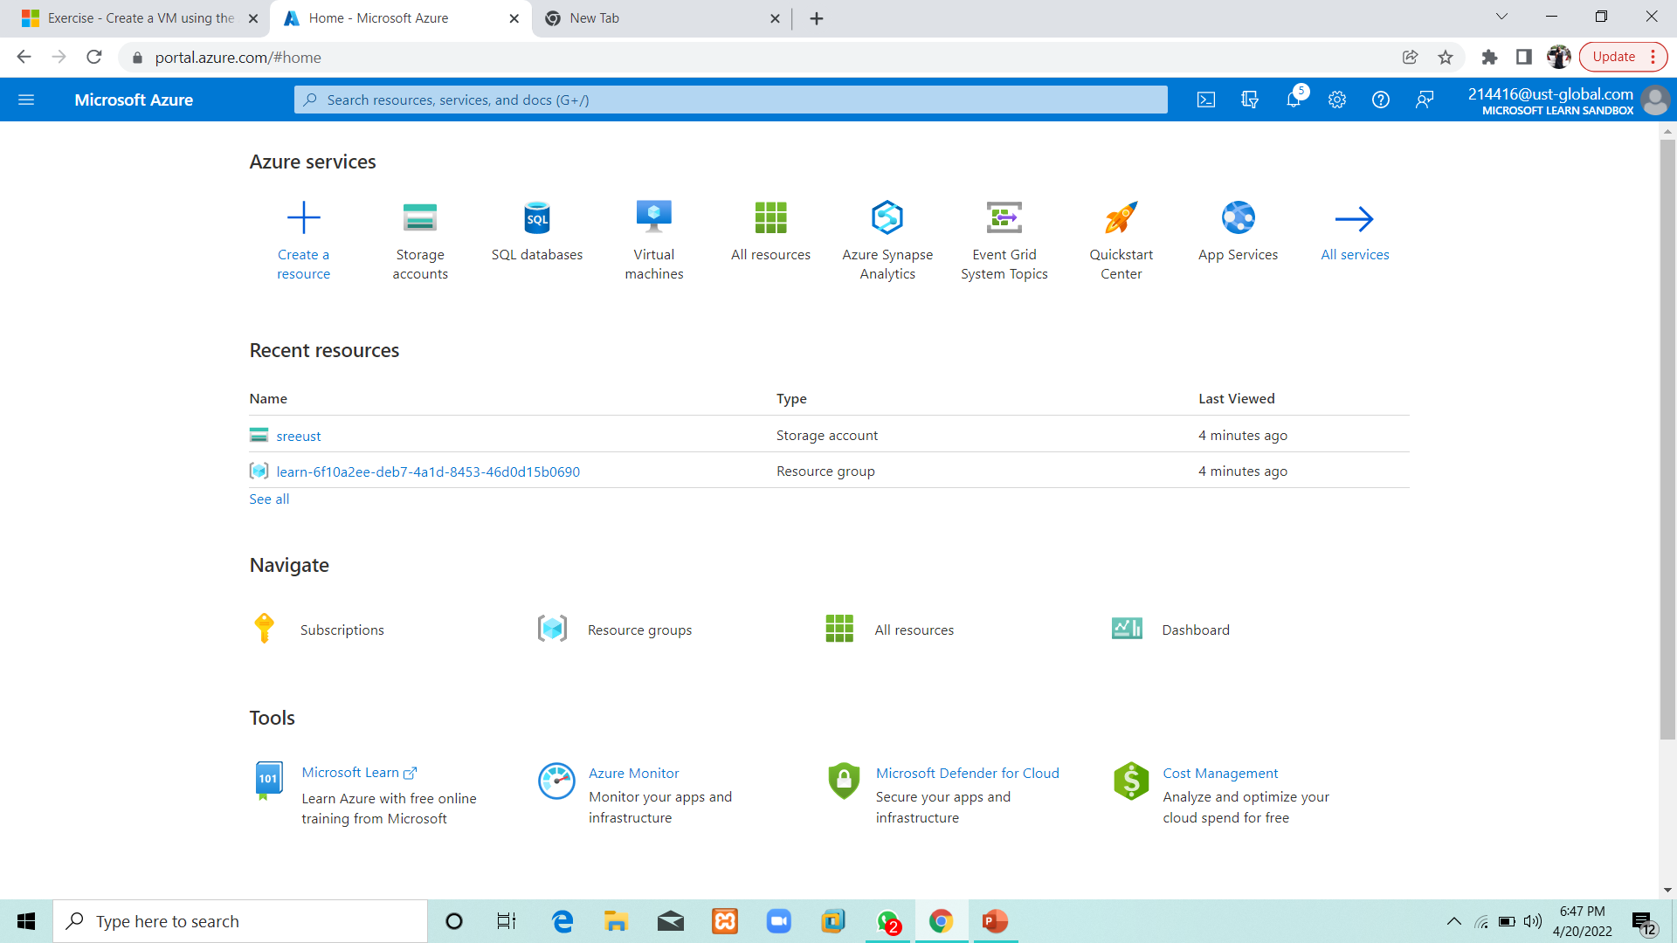
slide2 : Storage account in Azure

Slide 3
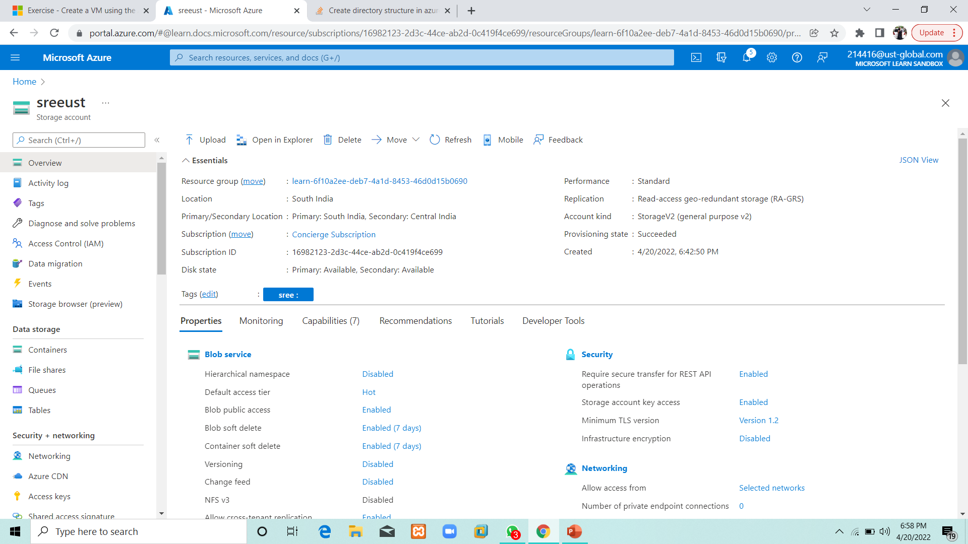

Slide 4
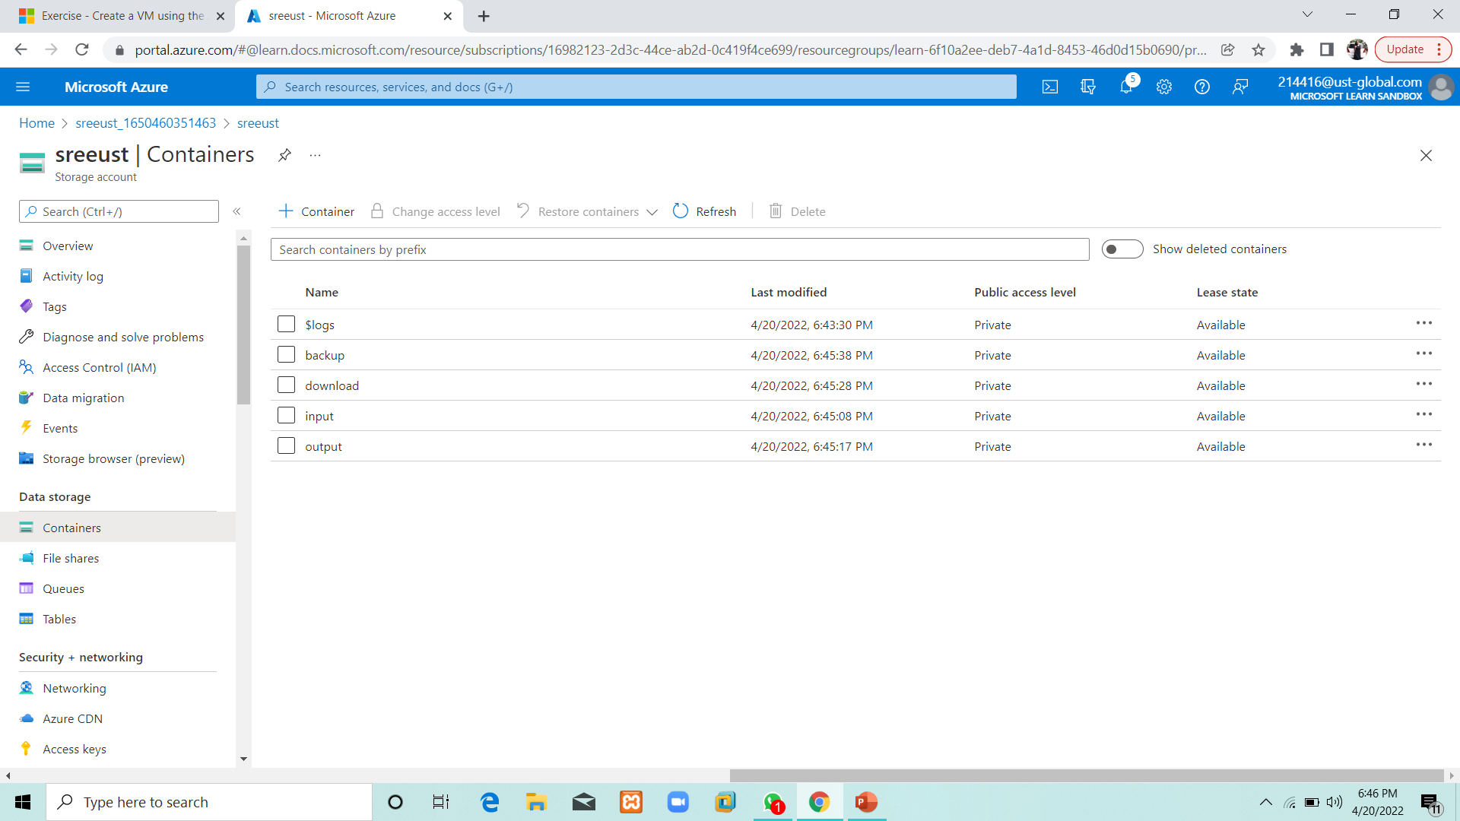
4 Containers

Slide 5
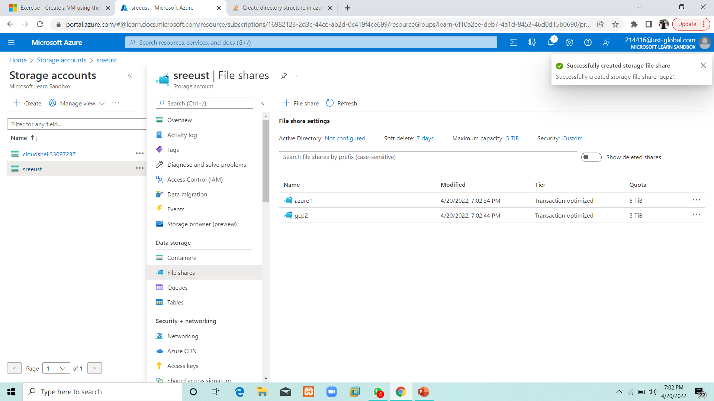
File share with directories

Slide 6
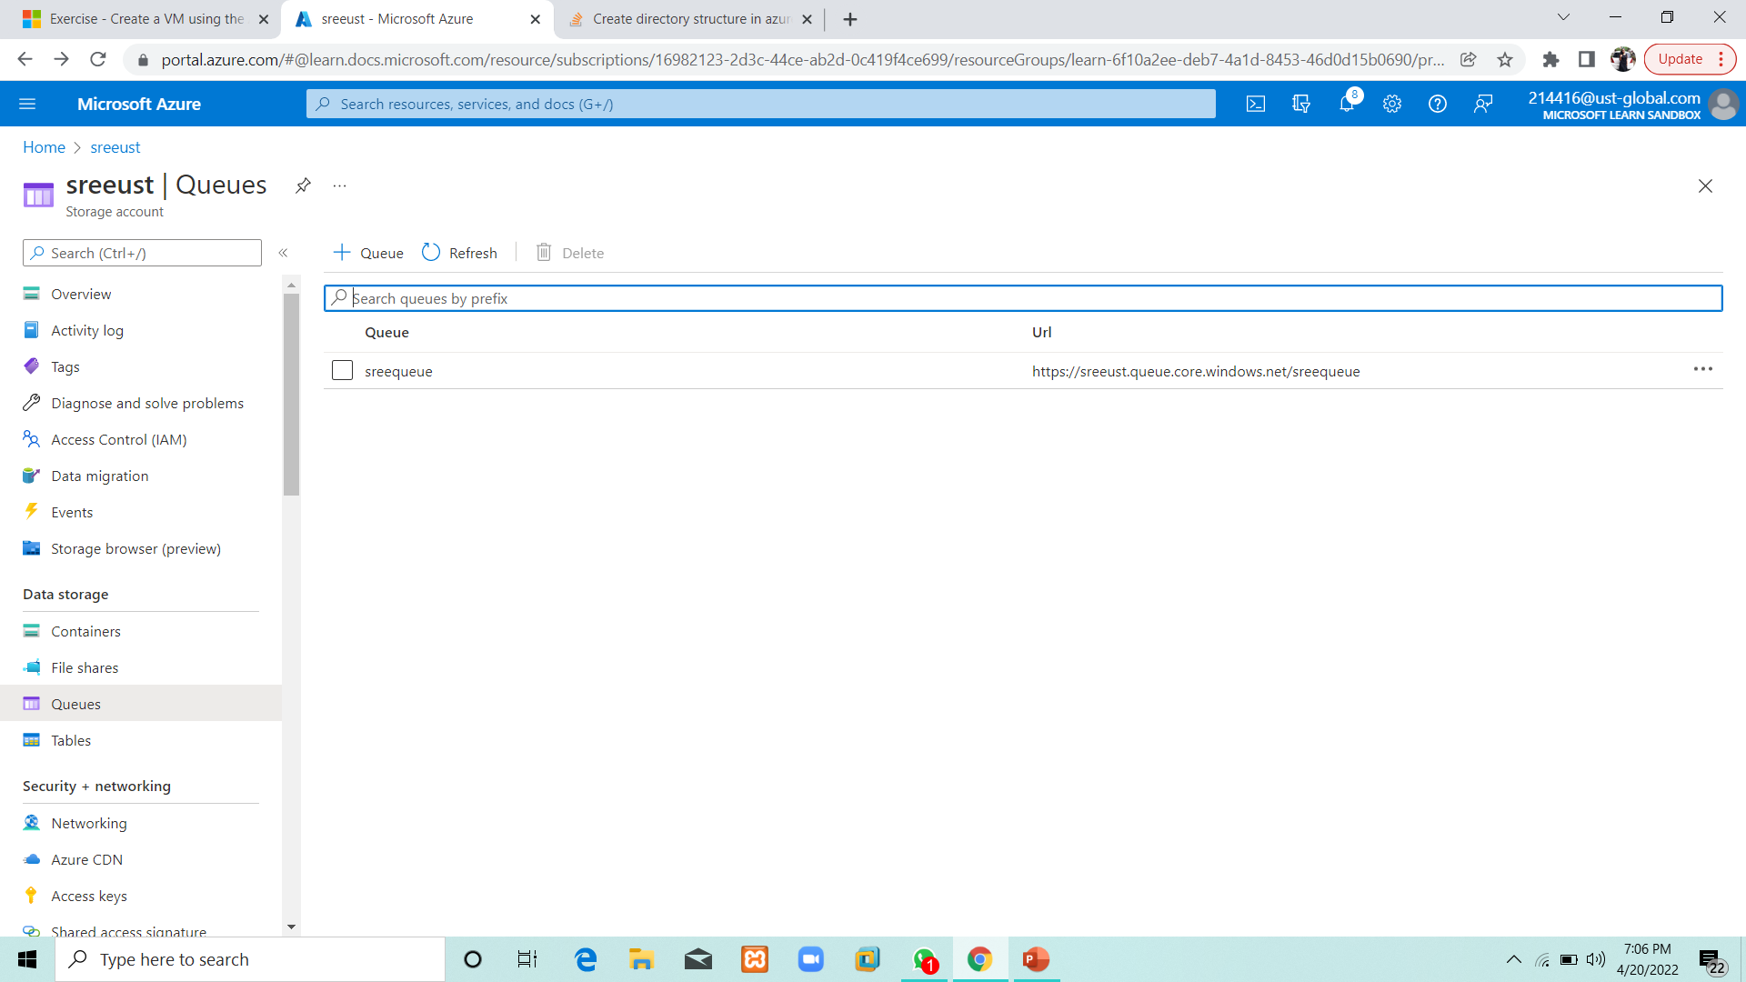
Queue

Slide 7
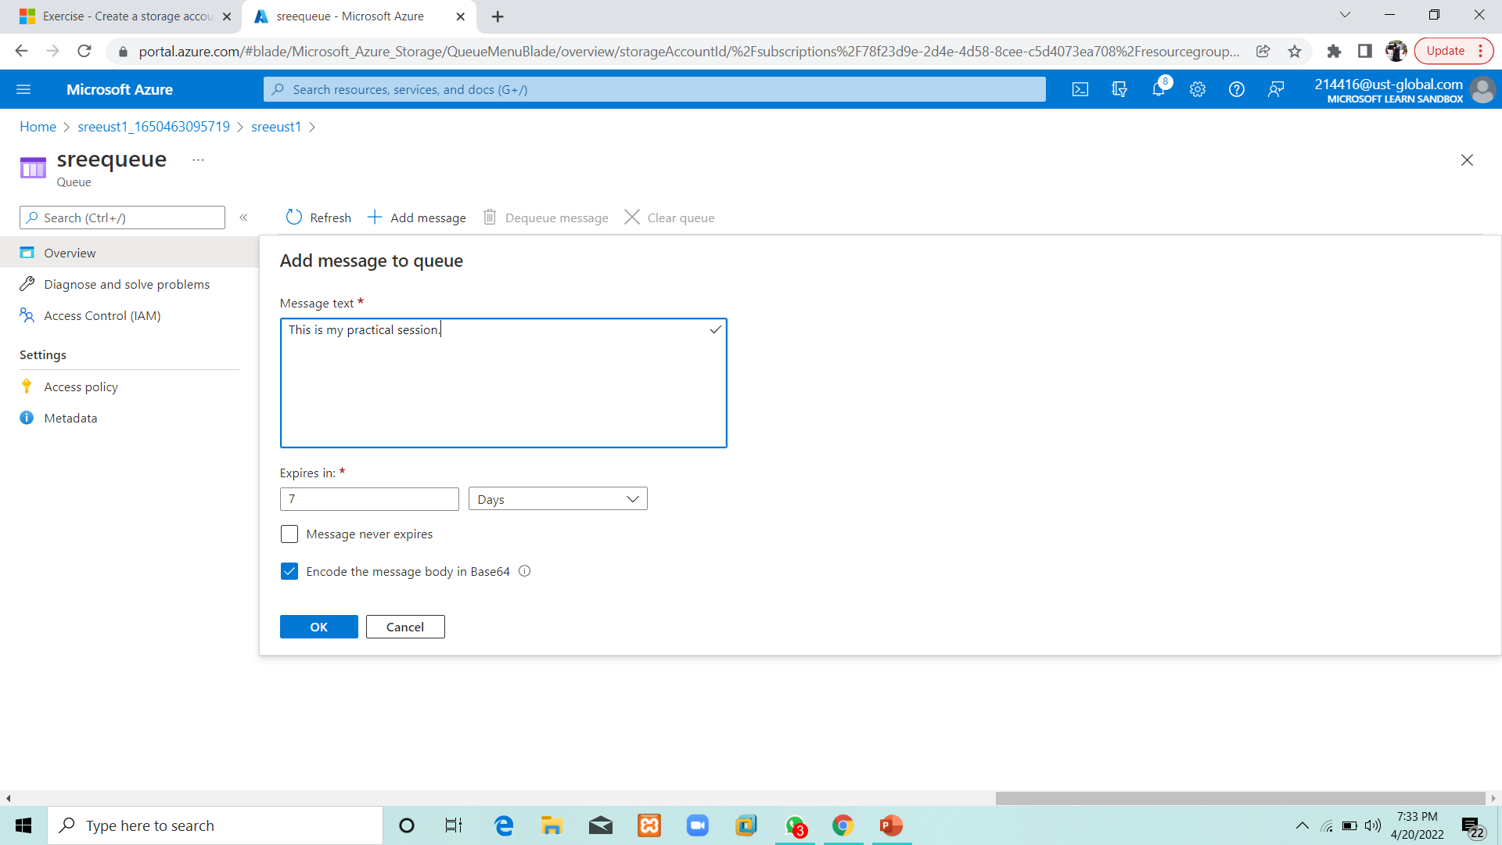
Message

Slide 8
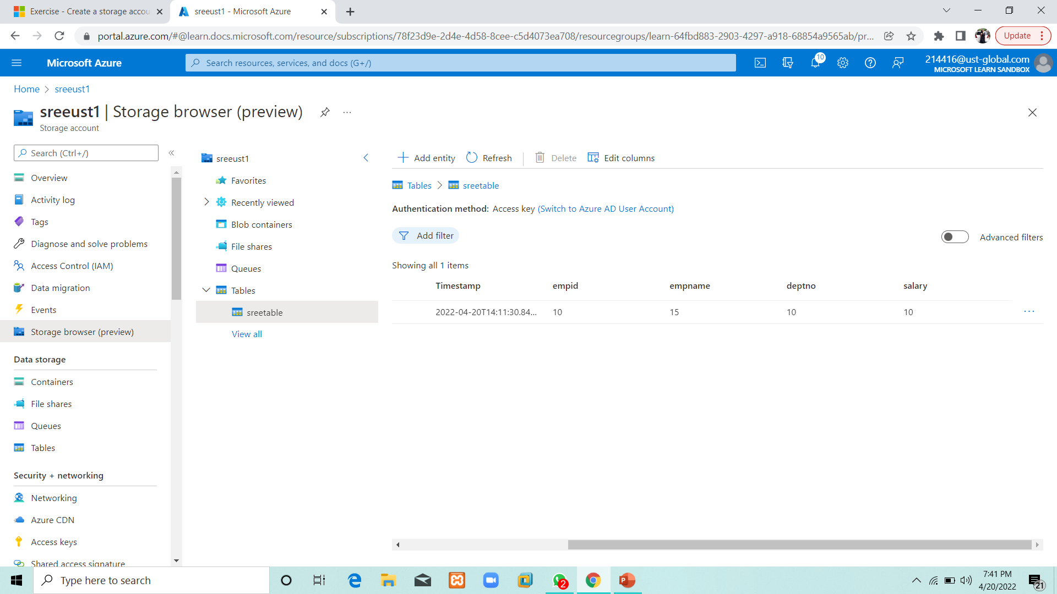
Table

Slide 9
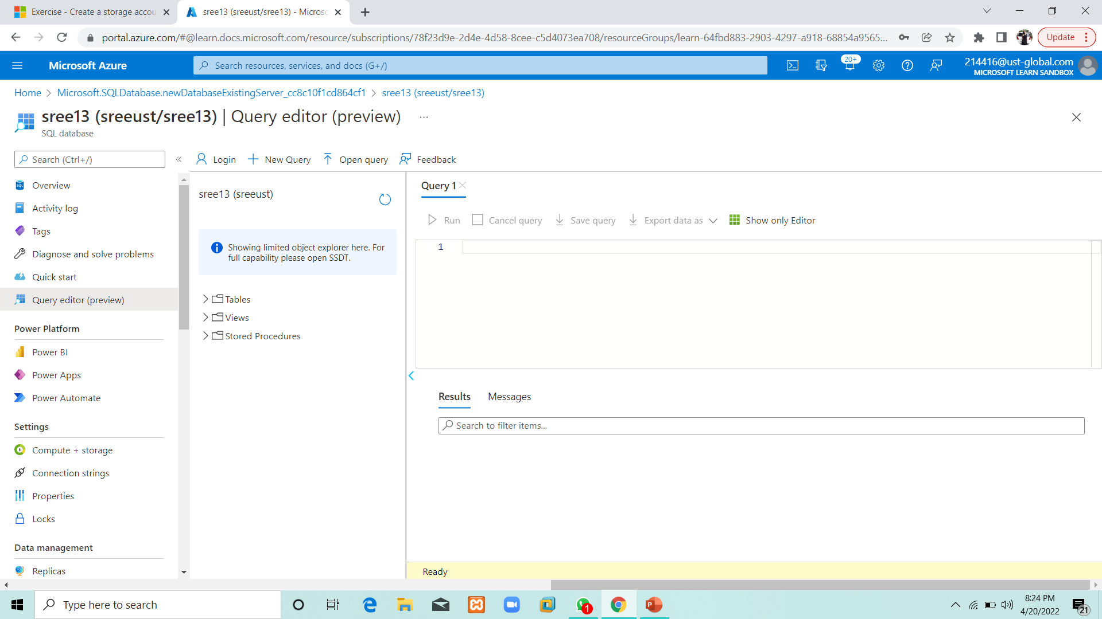
Database

Slide 10
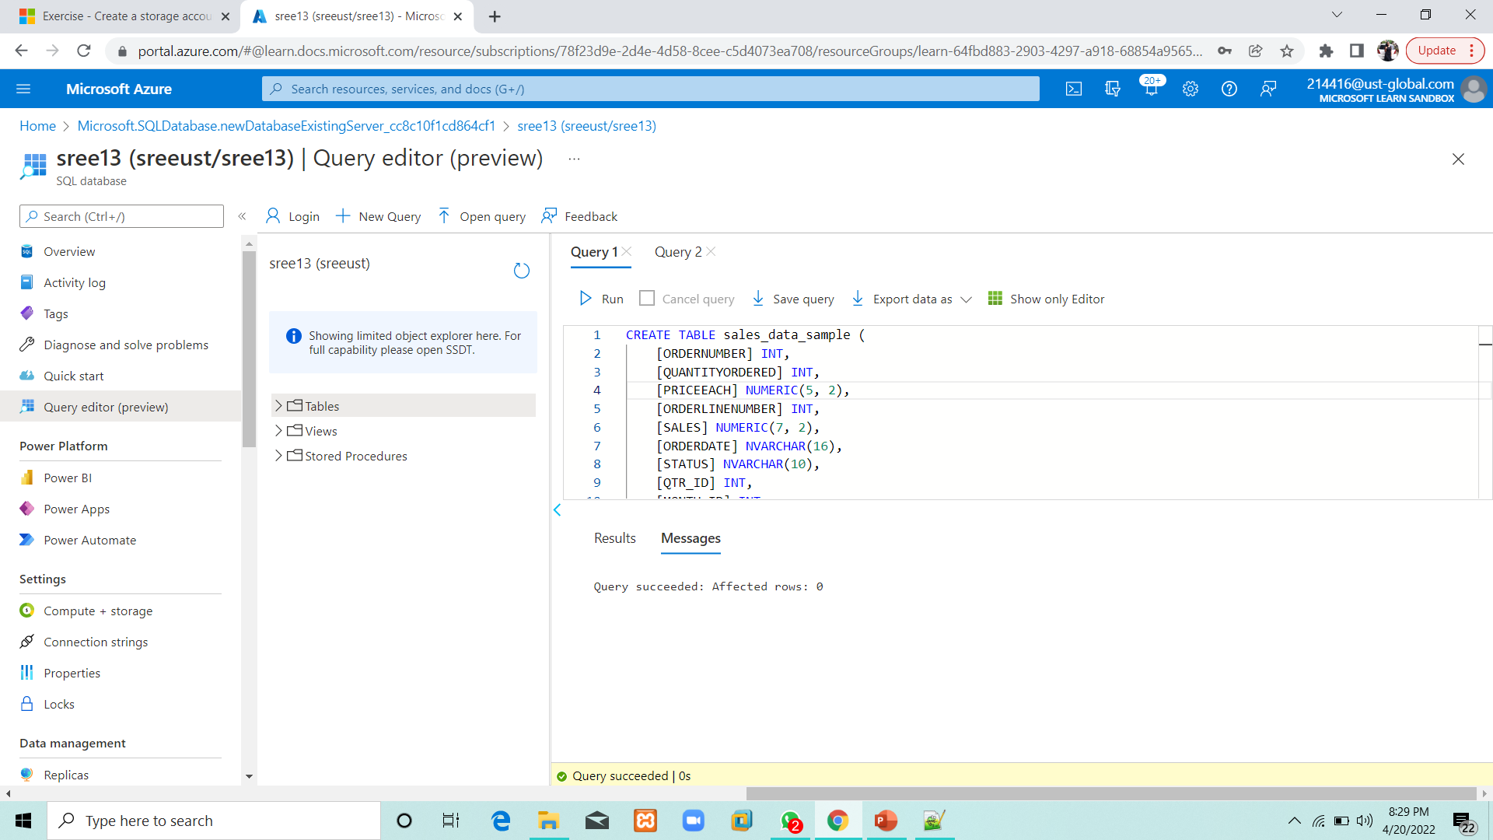
Query

Slide 11
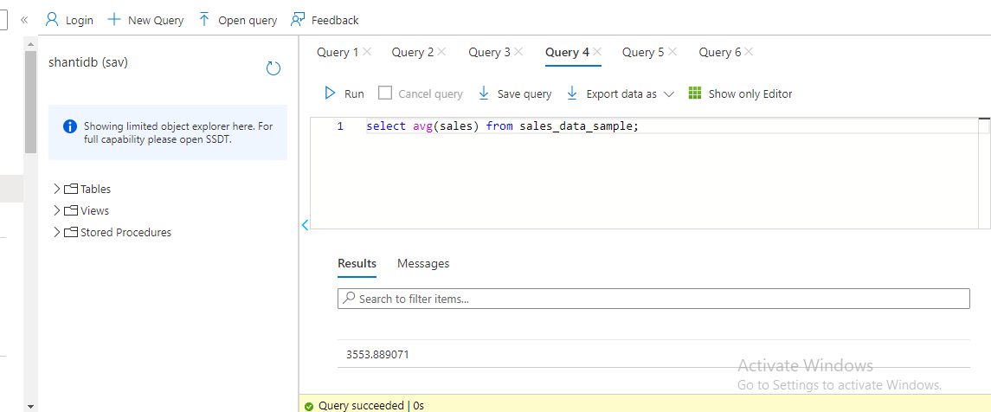
Sample database with Dimensions and fact table

Slide 12
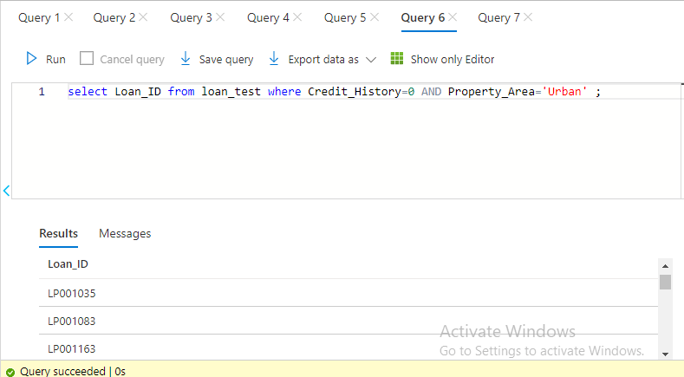
Financial need programs for consumer loan products

